Slide 1
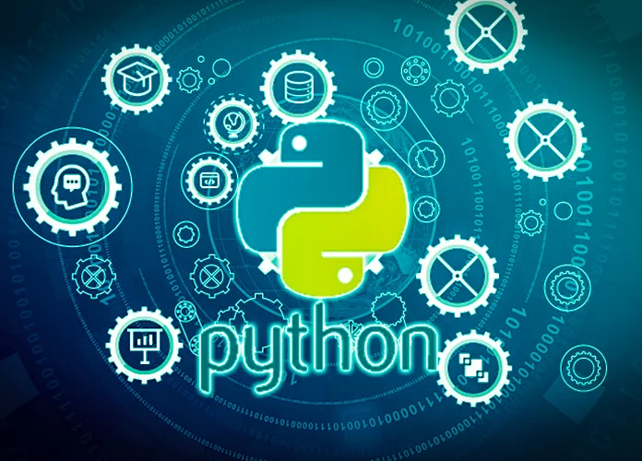
PYTHON PROGRAMMING FOR DATA SCIENCE

Slide 2

PYTHON PROGRAMMING FOR DATA SCIENCE
FIRST SEMESTER PPT
NAME:
VANSH KUMAR THAKUR
COURSE:
M.SC DATA SCIENCE
SEMESTER:
FIRST ( IST )
SUBMITTED TO:
MR RITESH
(ASSISTANT PROFESSOR)

Slide 3
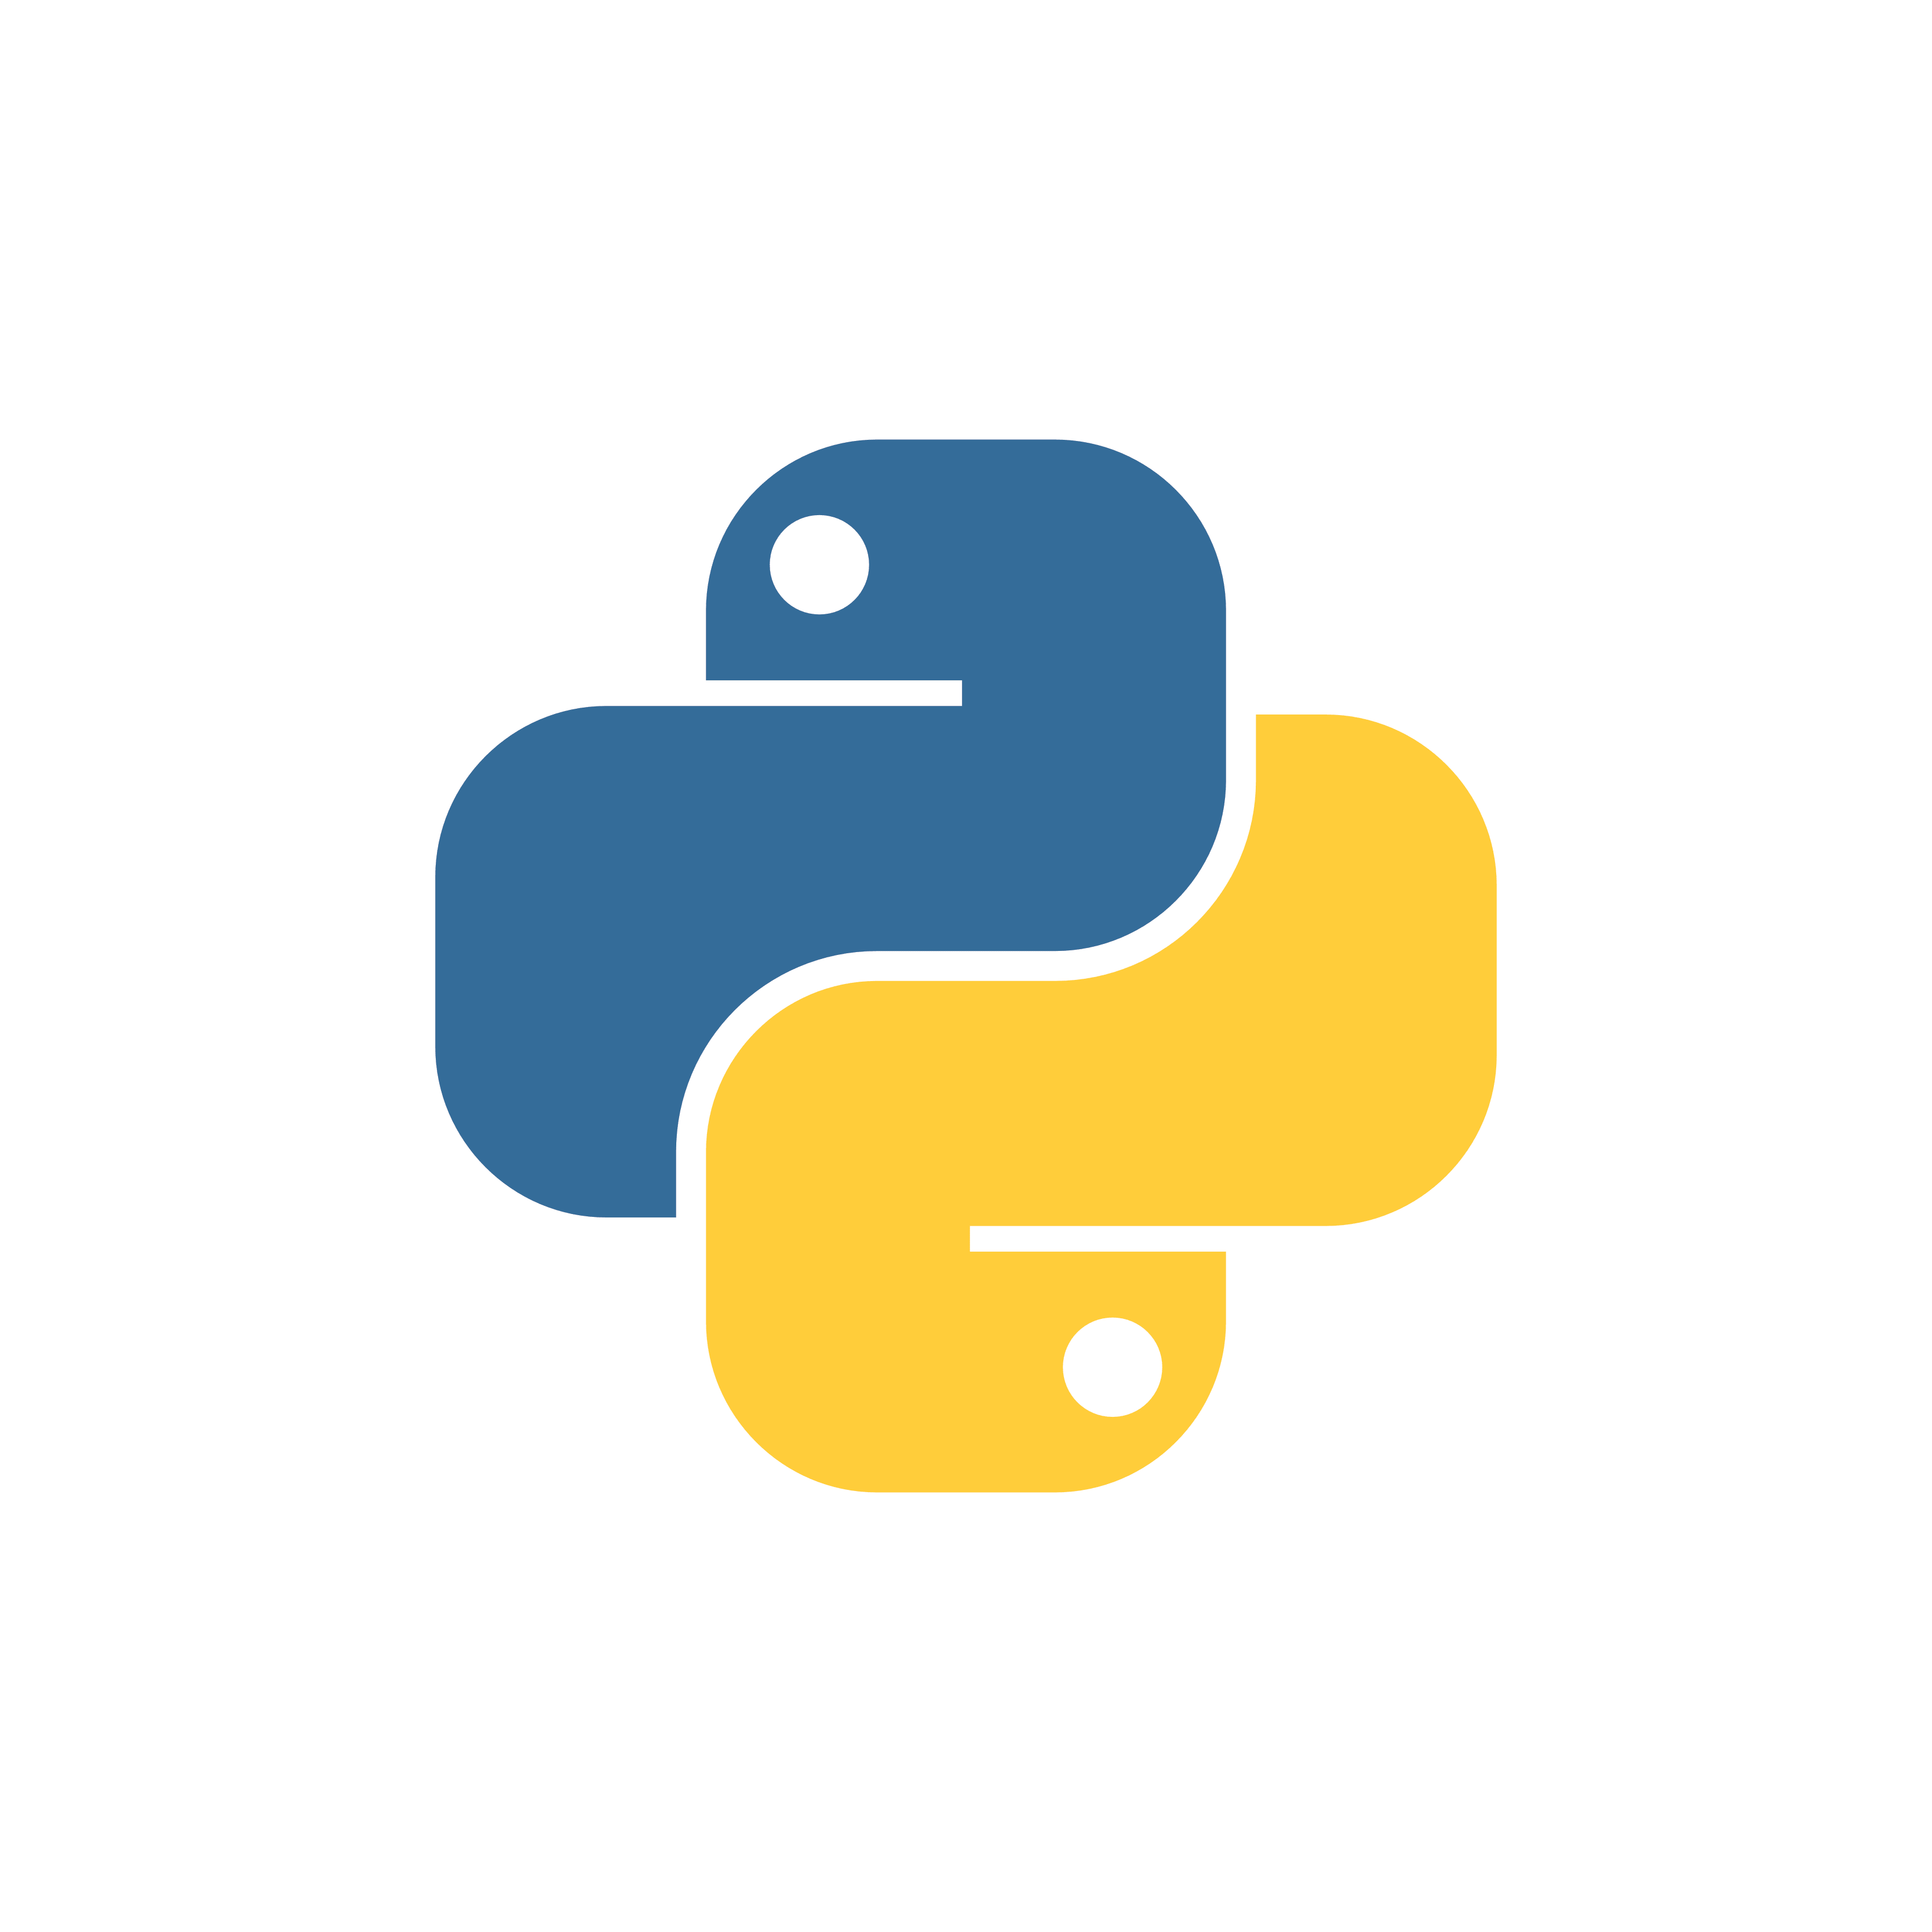
PYTHON PROGRAMMING LANGUAGE
HISTORY OF PYTHON:
Python was conceived in the late 1980s by Guido van Rossum at Centrum Wiskunde & Informatica (CWI) in the Netherlands as a successor to the ABC programming language, which was inspired by SETL, capable of exception handling and interfacing with the Amoeba operating system. Its implementation began in December 1989.
ABOUT PYTHON PROGRAMMING:
Python is a high-level, general-purpose programming language. Its design philosophy emphasizes code readability with the use of significant indentation.
Python is dynamically typed and garbage-collected. It supports multiple programming paradigms, including structured (particularly procedural), object-oriented and functional programming. It is often described as a "batteries included" language due to its comprehensive standard library.

Slide 4
LIST AND IT’S FUNCTIONS
Lists are used to store multiple items in a single variable.
Lists are one of 4 built-in data types in Python used to store collections of data, the other 3 are Tuple, Set, and Dictionary, all with different qualities and usage.
Lists are created using square brackets:
List supports multiple data types:

Slide 5
LIST FUNCTIONS
Function | Description
append() | Adds an element to the end of the list
extend() | Adds more than one element to the end of the list
insert() | Adds an element in between the list
remove() | Removes an elements from the list
pop() | Removes the last elements from the list
slice() | Prints a section of the list
reverse() | Reverses the order of the elements in a list
len() | Gives the length of a list
min() | Gives the minimum element (by value) of a list
max() | Gives the maximum element (by value) of a list
count() | Counts the number of copies in a list
Concatenate | Combines two list
Multiply | Multiplies the occurrence of elements in a list
index() | Gives index number of an element in the list
sort() | Sorts the list in ascending order
clear() | Clears every element in a list

Slide 6
TUPLE
Tuples are used to store multiple items in a single variable.
Tuple is one of 4 built-in data types in Python used to store collections of data, the other 3 are List, Set, and Dictionary, all with different qualities and usage.
A tuple is a collection which is ordered and unchangeable or immutable.
Tuples are written with round brackets:

Slide 7
Properties of a tuple
Immutable
Allows Duplicate
Allows Multiple Data Types
Ordered

Slide 8
TUPLE OPERATIONS
Built-in Function | Description
all() | Returns true if all element are true or if tuple is empty
any() | return true if any element of the tuple is true. if tuple is empty, return false
len() | Returns length of the tuple or size of the tuple
enumerate() | Returns enumerate object of tuple
max() | return maximum element of given tuple
min() | return minimum element of given tuple
sum() | Sums up the numbers in the tuple
sorted() | input elements in the tuple and return a new sorted list
tuple() | Convert an iterable to a tuple.
index( ) | Find in the tuple and returns the index of the given value where it’s available
count( ) | Returns the frequency of occurrence of a specified value

Slide 9
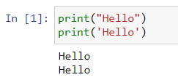
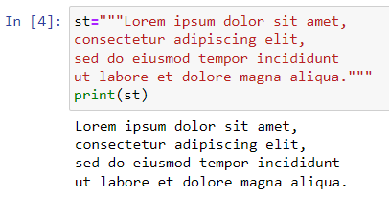

PYTHON STRINGS
Strings in python are surrounded by either single quotation marks, or double quotation marks. 'hello' is the same as "hello“.
I can be printed as follows:
Assigning string to a variable:
Multiline string:

Slide 10
Functions of a string
Method | Description
capitalize() | Converts the first character to upper case
casefold() | Converts string into lower case
center() | Returns a centered string
count() | Returns the number of times a specified value occurs in a string
encode() | Returns an encoded version of the string
endswith() | Returns true if the string ends with the specified value
expandtabs() | Sets the tab size of the string
find() | Searches the string for a specified value and returns the position of where it was found
format() | Formats specified values in a string
format_map() | Formats specified values in a string
index() | Searches the string for a specified value and returns the position of where it was found
isalnum() | Returns True if all characters in the string are alphanumeric
isalpha() | Returns True if all characters in the string are in the alphabet
isascii() | Returns True if all characters in the string are ascii characters
isdecimal() | Returns True if all characters in the string are decimals

Slide 11
Functions of a string
isdigit() | Returns True if all characters in the string are digits
isidentifier() | Returns True if the string is an identifier
islower() | Returns True if all characters in the string are lower case
isnumeric() | Returns True if all characters in the string are numeric
isprintable() | Returns True if all characters in the string are printable
isspace() | Returns True if all characters in the string are whitespaces
istitle() | Returns True if the string follows the rules of a title
isupper() | Returns True if all characters in the string are upper case
join() | Converts the elements of an iterable into a string
ljust() | Returns a left justified version of the string
lower() | Converts a string into lower case
lstrip() | Returns a left trim version of the string
maketrans() | Returns a translation table to be used in translations
partition() | Returns a tuple where the string is parted into three parts
replace() | Returns a string where a specified value is replaced with a specified value
rfind() | Searches the string for a specified value and returns the last position of where it was found
rindex() | Searches the string for a specified value and returns the last position of where it was found
rjust() | Returns a right justified version of the string

Slide 12
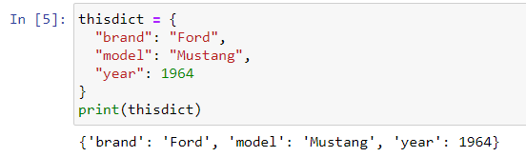
DICTIONARY
Dictionaries are used to store data values in key:value pairs.
A dictionary is a collection which is ordered*, changeable and do not allow duplicates.
CREATING AND PRINTING A DICTIONARY:

Slide 13
PROPERTIES OF A DICTIONARY
ORDERED OR UNORDERED?
When we say that dictionaries are ordered, it means that the items have a defined order, and that order will not change.
Unordered means that the items does not have a defined order, you cannot refer to an item by using an index.
CHANGEABLE
DUPLICATES NOT ALLOWED

Slide 14
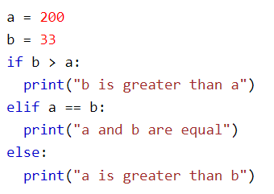
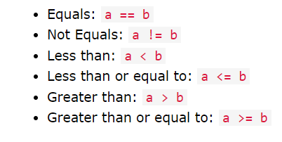
IF ELSE STATEMENT
The if-else statement in Python is used to execute a block of code only if a certain condition is true.
An "if statement" is written by using the if keyword.
The elif keyword is Python's way of saying "if the previous conditions were not true, then try this condition".
The else keyword catches anything which isn't caught by the preceding conditions.

Slide 15
FOR LOOP | WHILE LOOP
For loop is used to iterate over a sequence of items. | While loop is used to repeatedly execute a block of statements while a condition is true.
For loops are designed for iterating over a sequence of items. Eg. list, tuple, etc. | While loop is used when the number of iterations is not known in advance or when we want to repeat a block of code until a certain condition is met.
For loop require a sequence to iterate over. | While the loop requires an initial condition that is tested at the beginning of the loop.
For loop is typically used for iterating over a fixed sequence of items | While loop is used for more complex control flow situations.
For loop is more efficient than a while loop when iterating over sequences, since the number of iterations is predetermined and the loop can be optimized accordingly. | While a loop may be more efficient in certain situations where the condition being tested can be evaluated quickly.

Slide 16
FOR AND WHILE LOOP EXAMPLES
for i in range(10): print(i) # while loop i = 0 while i < 10: print(i) i += 1
list = [1, 2, 3, 4, 5] for i in list: print(i)
i = 0 while i < 10: print(i) i += 1

Slide 17
FUNCTIONS
A function is a block of code which only runs when it is called.
You can pass data, known as parameters, into a function.
A function can return data as a result.
CREATING A FUNCTION:
CALLING A FUNCTION:
def my_function(): print("Hello from a function") my_function()
def my_function(): print("Hello from a function")

Slide 18
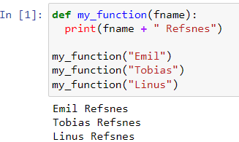
ARGUMENTS AND PARAMETERS IN FUNCTION
Information can be passed into functions as arguments.
Arguments are specified after the function name, inside the parentheses. You can add as many arguments as you want, just separate them with a comma.
The terms parameter and argument can be used for the same thing: information that are passed into a function.

Slide 19
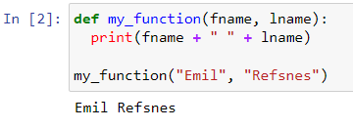
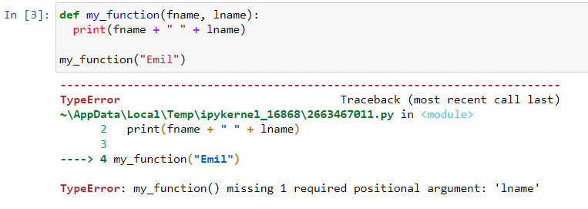
Number of Arguments:
By default, a function must be called with the correct number of arguments. Meaning that if your function expects 2 arguments, you have to call the function with 2 arguments, not more, and not less.
If you try to call the function with 1 or 3 arguments, you will get an error:

Slide 20
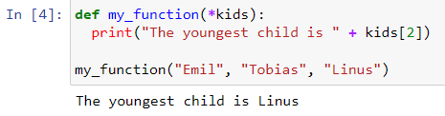
Arbitrary Arguments, *args
If you do not know how many arguments that will be passed into your function, add a * before the parameter name in the function definition. This way the function will receive a tuple of arguments, and can access the items accordingly:

Slide 21
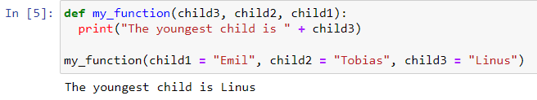
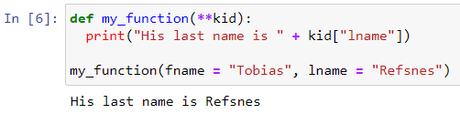
Keyword Arguments
You can also send arguments with the key = value syntax. This way the order of the arguments does not matter.
Arbitrary Keyword Arguments, **kwargs
If you do not know how many keyword arguments that will be passed into your function, add two asterisk: ** before the parameter name in the function definition. This way the function will receive a dictionary of arguments, and can access the items accordingly:

Slide 22
PANDAS
Pandas is a Python package providing fast, flexible, and expressive data structures designed to make working with “relational” or “labeled” data both easy and intuitive. It aims to be the fundamental high-level building block for doing practical, real-world data analysis in Python. Additionally, it has the broader goal of becoming the most powerful and flexible open source data analysis/manipulation tool available in any language. It is already well on its way toward this goal.
Pandas is well suited for many different kinds of data:
Tabular data with heterogeneously-typed columns, as in an SQL table or Excel spreadsheet
Ordered and unordered (not necessarily fixed-frequency) time series data.
Arbitrary matrix data (homogeneously typed or heterogeneous) with row and column labels
Any other form of observational / statistical data sets. The data need not be labeled at all to be placed into a pandas data structure

Slide 23
PANDAS
The two primary data structures of pandas, Series (1-dimensional) and DataFrame (2-dimensional), handle the vast majority of typical use cases in finance, statistics, social science, and many areas of engineering. For R users, DataFrame provides everything that R’s data.frame provides and much more. pandas is built on top of NumPy and is intended to integrate well within a scientific computing environment with many other 3rd party libraries.

Slide 24
Attributes
T | The transpose of the DataFrame.
at | Access a single value for a row/column label pair.
attrs | Dictionary of global attributes of this dataset.
axes | Return a list representing the axes of the DataFrame.
columns | The column labels of the DataFrame.
dtypes | Return the dtypes in the DataFrame.
empty | Indicator whether Series/DataFrame is empty.
flags | Get the properties associated with this pandas object.
iat | Access a single value for a row/column pair by integer position.
iloc | Purely integer-location based indexing for selection by position.
index | The index (row labels) of the DataFrame.
loc | Access a group of rows and columns by label(s) or a boolean array.
ndim | Return an int representing the number of axes / array dimensions.
shape | Return a tuple representing the dimensionality of the DataFrame.
size | Return an int representing the number of elements in this object.
style | Returns a Styler object.
values | Return a Numpy representation of the DataFrame.

Slide 25
Matplotlib: Visualization with Python
Matplotlib is a comprehensive library for creating static, animated, and interactive visualizations in Python. Matplotlib makes easy things easy and hard things possible.
Create publication quality plots.
Make interactive figures that can zoom, pan, update.
Customize visual style and layout.
Export to many file formats.
Embed in JupyterLab and Graphical User Interfaces.
Use a rich array of third-party packages built on Matplotlib.

Slide 26
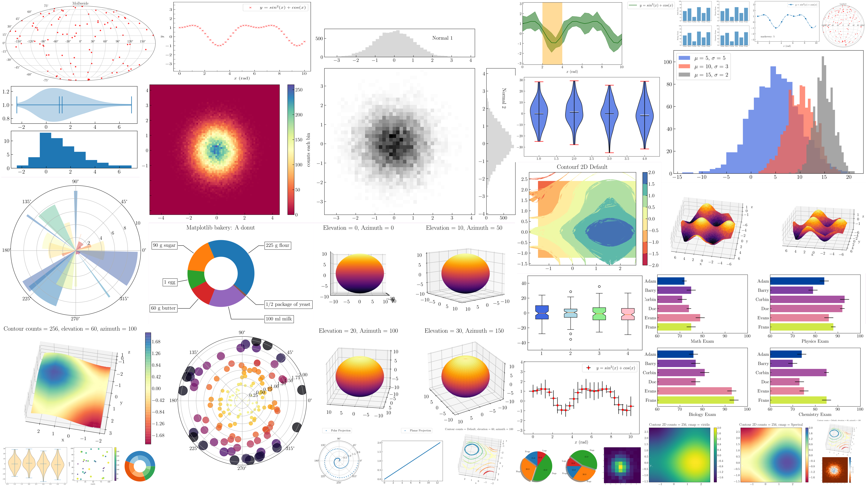
GRAPHS AND PLOTS BY MATPLOTLIB

Slide 27
FILE HANDLING
The key function for working with files in Python is the open() function.
The open() function takes two parameters; filename, and mode.
There are four different methods (modes) for opening a file:
"r" - Read - Default value. Opens a file for reading, error if the file does not exist
"a" - Append - Opens a file for appending, creates the file if it does not exist
"w" - Write - Opens a file for writing, creates the file if it does not exist
"x" - Create - Creates the specified file, returns an error if the file exists
In addition you can specify if the file should be handled as binary or text mode
"t" - Text - Default value. Text mode
"b" - Binary - Binary mode (e.g. images)

Slide 28


FILE HANDLING
SYNTAX:
TO OPEN A FILE:
The open() function returns a file object, which has a read() method for reading the content of the file.
Read Only Parts of the File:

Slide 29

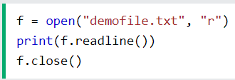
FILE HANDLING
Read Lines: You can return one line by using the readline() method
Close Files: It is a good practice to always close the file when you are done with it.

Slide 30
THANK YOU

